Slide 1


Slide 8
Type | Num Filters / Neurons | Filter / Pool Size | Stride | Activation Function | Dropout
Convolutional | 64 | 8 | 1 | ReLU | -
MaxPooling | - | 8 | 8 | - | -
Convolutional | 32 | 8 | 1 | ReLU | -
Convolutional | 32 | 16 | 1 | ReLU | -
MaxPooling | - | 6 | 6 | - | -
Convolutional | 16 | 16 | 1 | ReLU | -
Convolutional | 16 | 32 | 1 | ReLU | -
MaxPooling | - | 4 | 4 | - | -
Convolutional | 16 | 32 | 1 | ReLU | -
Dense | 64 | - | - | ReLU | 0.5
Dense | 64 | - | - | ReLU | 0.5
Dense | 2 | - | - | SoftMax | -
Input timeseries
Type | Num Filters / Neurons / Heads | Filter / Pool / Head Size | Stride | Activation Function | Dropout
Convolutional | 64 | 8 | 1 | ReLU | -
MaxPooling | - | 8 | 8 | - | -
Convolutional | 32 | 8 | 1 | ReLU | -
Convolutional | 32 | 16 | 1 | ReLU | -
MaxPooling | - | 6 | 6 | - | -
Convolutional | 16 | 16 | 1 | ReLU | -
Convolutional | 16 | 32 | 1 | ReLU | -
MaxPooling | - | 4 | 4 | - | -
Convolutional | 128 | 1 | 1 | ReLU | -
Positional Encoding | - | - | - | - | -
Input timeseries
Multi-Attention Head | 8 | 16 | - | ReLU | 0.0
Dense | 64 | - | - | ReLU | 0.1
Dense | 2 | - | - | ReLU | 0.1
Binary Classification
Dense | 500 | - | - | ReLU | 0.1
Dense | 2 | - | - | SoftMax | -
Input timeseries
Binary Classification
Type | Num Filters / Neurons / Heads | Filter / Pool / Head Size | Stride | Activation Function | Dropout
Convolutional | 128 | 1 | 1 | ReLU | -
Positional Encoding | - | - | - | - | -
Multi-Attention Head | 8 | 16 | - | ReLU | -
Dense | 64 | - | - | ReLU | 0.1
Dense | 2 | - | - | ReLU | 0.1
×8
Attention Blocks
Dense | 64 | - | - | ReLU | 0.1
Dense | 2 | - | - | SoftMax | -
Binary Classification

Slide 9
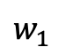
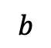

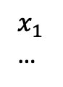
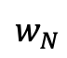
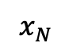
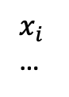
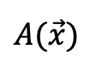
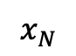
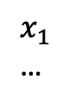
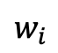
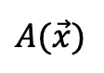
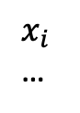
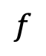
Artificial Intelligence
Artificial Neural Networks
Deep Learning
Machine Learning
$x_{1}$
…
$$w_{1}$$
$x_{i}$
…
$$w_{i}$$
$$b$$
$$f$$
$$A(\vec{x})$$
$x_{N}$
$$w_{N}$$
$x_{1}$
…
$x_{i}$
…
$$A$$
$$A(\vec{x})$$
$x_{N}$

Slide 10
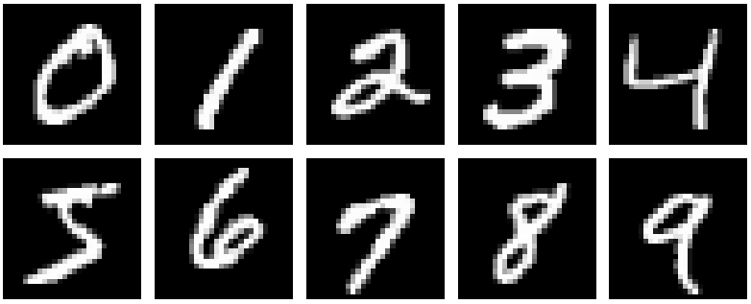
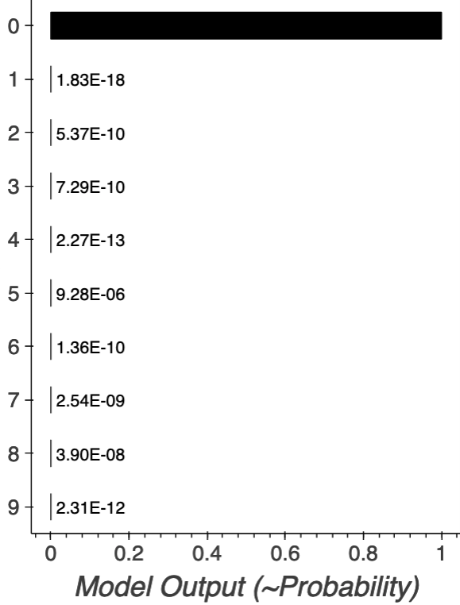
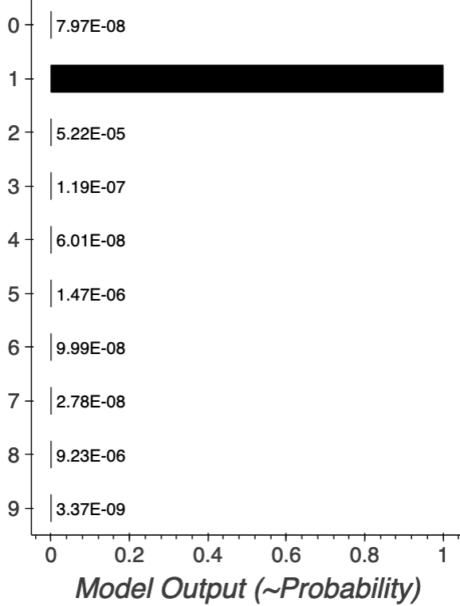
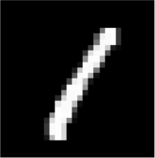
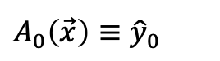

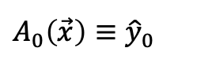
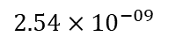
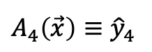
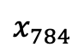
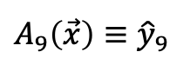
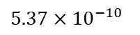
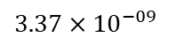
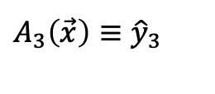
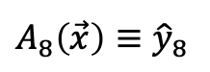
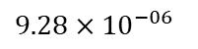

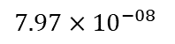
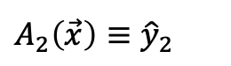
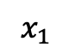
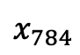

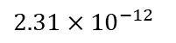
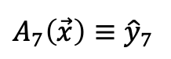
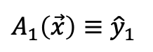
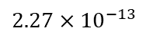
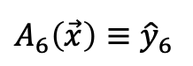
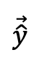
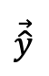
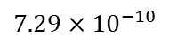
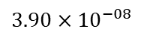
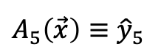
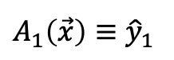
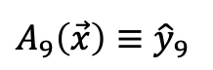
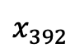
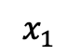


…
$x_{1}$
$$A_{0}\left(\vec{x}\right)≡{\hat{y}}_{0}$$
$$1.00×{10}^{+00}$$
$$A_{1}\left(\vec{x}\right)≡{\hat{y}}_{1}$$
$$1.83×{10}^{−18}$$
$$A_{2}\left(\vec{x}\right)≡{\hat{y}}_{2}$$
$$5.37×{10}^{−10}$$
$$A_{3}\left(\vec{x}\right)≡{\hat{y}}_{3}$$
$$7.29×{10}^{−10}$$
$$1.00×{10}^{00}$$
flatten
$$x_{392}$$
$$A_{4}\left(\vec{x}\right)≡{\hat{y}}_{4}$$
$$2.27×{10}^{−13}$$
$$\vec{\hat{y}}$$
$$A_{5}\left(\vec{x}\right)≡{\hat{y}}_{5}$$
$$9.28×{10}^{−06}$$
$$A_{6}\left(\vec{x}\right)≡{\hat{y}}_{6}$$
$$9.28×{10}^{−10}$$
…
$$A_{7}\left(\vec{x}\right)≡{\hat{y}}_{7}$$
$$2.54×{10}^{−09}$$
$$A_{8}\left(\vec{x}\right)≡{\hat{y}}_{8}$$
$$3.90×{10}^{−08}$$
$$x_{784}$$
$$A_{9}\left(\vec{x}\right)≡{\hat{y}}_{9}$$
$$2.31×{10}^{−12}$$
…
$x_{1}$
$$A_{0}\left(\vec{x}\right)≡{\hat{y}}_{0}$$
$$7.97×{10}^{−08}$$
flatten
$$A_{1}\left(\vec{x}\right)≡{\hat{y}}_{1}$$
$$1.00×{10}^{+00}$$
$$\vec{\hat{y}}$$
…
$$x_{784}$$
$$A_{9}\left(\vec{x}\right)≡{\hat{y}}_{9}$$
$$3.37×{10}^{−09}$$
Type | Num Filters / Neurons / Heads | Filter / Pool / Head Size | Stride | Activation Function | Dropout
Dense | 10 | - | - | SoftMax | -
Input Image
Classification Vector

Slide 11
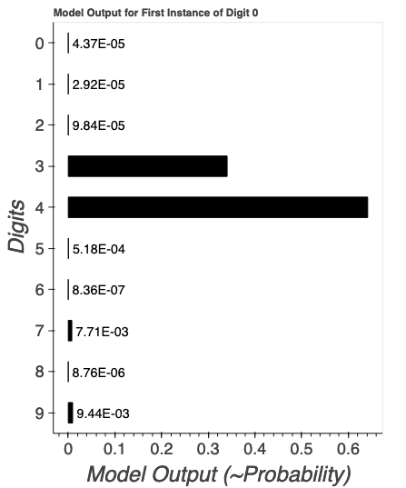
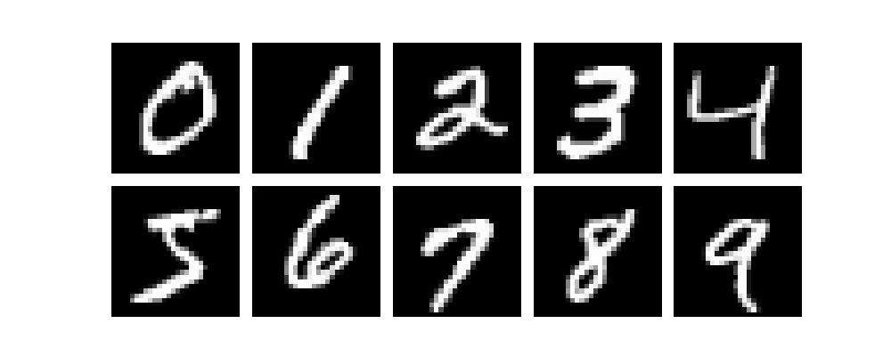

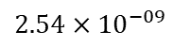
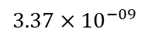




…
$x_{1}$
$$A_{0}\left(\vec{x}\right)≡{\hat{y}}_{0}$$
$$1.00×{10}^{+00}$$
$$A_{1}\left(\vec{x}\right)≡{\hat{y}}_{1}$$
$$1.83×{10}^{−18}$$
$$A_{2}\left(\vec{x}\right)≡{\hat{y}}_{2}$$
$$5.37×{10}^{−10}$$
$$A_{3}\left(\vec{x}\right)≡{\hat{y}}_{3}$$
$$7.29×{10}^{−10}$$
$$1.00×{10}^{00}$$
flatten
$$x_{392}$$
$$A_{4}\left(\vec{x}\right)≡{\hat{y}}_{4}$$
$$2.27×{10}^{−13}$$
$$\vec{\hat{y}}$$
$$A_{5}\left(\vec{x}\right)≡{\hat{y}}_{5}$$
$$9.28×{10}^{−06}$$
$$A_{6}\left(\vec{x}\right)≡{\hat{y}}_{6}$$
$$9.28×{10}^{−10}$$
…
$$A_{7}\left(\vec{x}\right)≡{\hat{y}}_{7}$$
$$2.54×{10}^{−09}$$
$$A_{8}\left(\vec{x}\right)≡{\hat{y}}_{8}$$
$$3.90×{10}^{−08}$$
$$x_{784}$$
$$A_{9}\left(\vec{x}\right)≡{\hat{y}}_{9}$$
$$2.31×{10}^{−12}$$
…
$x_{1}$
$$A_{0}\left(\vec{x}\right)≡{\hat{y}}_{0}$$
$$7.97×{10}^{−08}$$
flatten
$$A_{1}\left(\vec{x}\right)≡{\hat{y}}_{1}$$
$$1.00×{10}^{+00}$$
$$\vec{\hat{y}}$$
…
$$x_{784}$$
$$A_{9}\left(\vec{x}\right)≡{\hat{y}}_{9}$$
$$3.37×{10}^{−09}$$
model
model

Slide 12




























input vector
(784 elements)
hidden layer
(N = 128 neurons)
output layer
(C = 10 neurons)
…
$x_{1}$
$${\hat{y}}_{0}$$
$$1.37×{10}^{−08}$$
$$A_{1}$$
$${\hat{y}}_{1}$$
$$5.04×{10}^{−10}$$
$${\hat{y}}_{2}$$
…
$$1.13 ×{10}^{−13}$$
$${\hat{y}}_{3}$$
$$1.53×{10}^{−07}$$
flatten
$$x_{392}$$
$$A_{i}$$
$${\hat{y}}_{4}$$
$$1.70×{10}^{−10}$$
$$\vec{\hat{y}}$$
$${\hat{y}}_{5}$$
$$1.00×{10}^{−00}$$
$${\hat{y}}_{6}$$
$$9.64×{10}^{−07}$$
…
$$A_{N}$$
$${\hat{y}}_{7}$$
$$9.58×{10}^{−11}$$
$${\hat{y}}_{8}$$
$$1.20×{10}^{−07}$$
$$x_{784}$$
$${\hat{y}}_{9}$$
$$5.29×{10}^{−07}$$
Type | Num Filters / Neurons / Heads | Filter / Pool / Head Size | Stride | Activation Function | Dropout
Dense | 128 | - | - | ReLU | -
Dense | 10 | - | - | SoftMax | -
Input Image
Classification Vector

Slide 13


















$x_{1}$
$$A_{1}$$
$${\hat{y}}_{0}$$
$x_{1}$
$$A_{1}$$
$${\hat{y}}_{0}$$
$$x_{i}$$
$$A_{j}$$
$${\hat{y}}_{k}$$
$$x_{i}$$
$$A_{j}$$
$${\hat{y}}_{k}$$
$$x_{N}$$
$$A_{H}$$
$${\hat{y}}_{O}$$
$$x_{N}$$
$$A_{H}$$
$${\hat{y}}_{O}$$
Type | Num Filters / Neurons | Filter / Pool Size | Stride | Activation Function | Dropout
Whitening | - | - | - | - | -
Dense | 1 | - | - | SoftMax | -
off-source
on-source
Binary Classification
Type | Num Filters / Neurons | Filter / Pool Size | Stride | Activation Function | Dropout
Whitening | - | - | - | - | -
Dense | 64/128/256 | - | - | ReLU | -
Dense | 1 | - | - | SoftMax | -
off-source
on-source
Binary Classification
Type | Num Filters / Neurons | Filter / Pool Size | Stride | Activation Function | Dropout
Whitening | - | - | - | - | -
Dense | 64/128/256 | - | - | ReLU | -
Dense | 64/128/256 | - | - | ReLU | -
Dense | 1 | - | - | SoftMax | -
off-source
on-source
Binary Classification
Type | Num Filters / Neurons | Filter / Pool Size | Stride | Activation Function | Dropout
Whitening | - | - | - | - | -
Dense | 64/128/256 | - | - | ReLU | -
Dense | 64/128/256 | - | - | ReLU | -
Dense | 64/128/256 | - | - | ReLU | -
Dense | 1 | - | - | SoftMax | -
off-source
on-source
Binary Classification

Slide 14




































$x_{1}$
$$k_{1_1}$$
$x_{2}$
$$k_{1_2}$$
$x_{3}$
$x_{4}$
$x_{5}$
$$k_{1_3}$$
$x_{1}$
$$k_{1_1}$$
$x_{1}$
$$k_{1_1}$$
$x_{2}$
$$k_{2_1}$$
$x_{2}$
$$k_{2_1}$$
$x_{3}$
$$k_{1_2}$$
$$k_{2_1}$$
$x_{3}$
$$k_{2_1}$$
$x_{4}$
$$k_{2_2}$$
$x_{4}$
$$k_{1_2}$$
$$k_{2_2}$$
$x_{5}$
$$k_{1_3}$$
$$k_{2_2}$$
$x_{5}$
$$k_{2_2}$$
$$k_{2_3}$$
$$k_{1_3}$$
$$k_{2_3}$$
$$k_{2_3}$$
$$k_{2_3}$$

Slide 18







































$x_{1}$
$$A_{1}$$
$${\hat{y}}_{0}$$
$x_{1}$
$$A_{1}$$
$${\hat{y}}_{0}$$
$$x_{i}$$
$$A_{j}$$
$${\hat{y}}_{k}$$
$$x_{i}$$
$$A_{j}$$
$${\hat{y}}_{k}$$
$$x_{N}$$
$$A_{H}$$
$${\hat{y}}_{O}$$
$$x_{N}$$
$$A_{H}$$
$${\hat{y}}_{O}$$
$x_{1}$
$$A_{1}^{1}$$
$$A_{1}^{T}$$
$${\hat{y}}_{0}$$
$x_{1}$
$$A_{1}$$
$${\hat{y}}_{0}$$
$$x_{i}$$
$$A_{j}^{1}$$
$$A_{j}^{T}$$
$${\hat{y}}_{k}$$
$$x_{i}$$
$$A_{j}$$
$${\hat{y}}_{k}$$
$$x_{N}$$
$$A_{H}^{1}$$
$$A_{H}^{T}$$
$${\hat{y}}_{O}$$
$$x_{N}$$
$$A_{H}$$
$${\hat{y}}_{O}$$

